Slide 1
Cylindrical shell

Slide 2
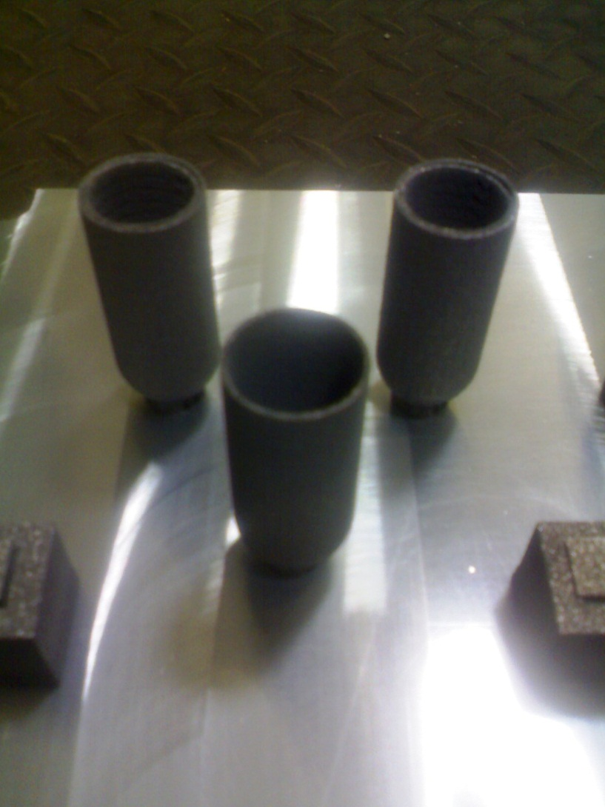
Cylindrical shell on platform

Slide 3
